Slide 1




Next Gen Employability Program
FullStack Web Development With AI Tools
Team Details – NG_CP_Team_664
Name: Rahul Kargeti
Name: Praveen Mathur
Name: Rajeev Pratap Gupta
College: Inderprastha Engineering College, Ghaziabad

Slide 2

The content is curated from online/offline resources and used for educational purpose only.
Notes:
Speaker would be briefing the students that this content has been prepared for the educational purpose only and is referred from multiple sites which are cited in the last.​​
---------------------------------------------------​​
A disclaimer is a statement or notice that is intended to clarify, limit, or provide information about the scope, limitations, or potential risks associated with certain actions, information, products, services, or content. ​​
​​
​

Slide 3

Project Title
Blockchain Based Medicine Authenticity System
Notes:
In this slide speaker will be introducing the program and its outcomes. The speaker will introduce himself in brief

Slide 4

Table of Contents
Introduction
Problem Statement
Proposed Solution
Key features
Technology stack
System flowchart
Core Modules
Security measures
Conclusion and Future work
References
Notes:
This slide, The speaker will talk about the content that we will be covering in this session as follows:
Introduction
Importance of UI/UX in industry
History and Definitions of UI and UX
Key Differences between UI/UX
Use Cases
Significance in Web Development
Use Cases
Visual Design Principles
Design process
Color theory and psychology
Typography and readability
Layout and Spacing
Responsive design basics
Usability and Accessibility
Usability Aspects
Web Content Accessibility Guidelines (WCAG)
Inclusive design practices
Consistency
User Experience
User-Centered Design
User research methods
Interactive Elements and Feedback
Mini Case Study
Discussing a popular UI/UX design
Hands-On
Introduction to Figma for UI/UX design

Slide 5

Introduction:
The pharmaceutical industry currently lacks a comprehensive system to monitor the supply chain, leading to the widespread circulation of counterfeit medicines—a problem that worsened during the COVID-19 pandemic. These fake medicines pose serious health risks, causing over 1 million deaths annually and $21 billion in global economic losses (WHO). To address this, we propose a Blockchain-based medicine authentication system. Its immutability prevents tampering and ensures authenticity while enabling real-time tracking throughout the supply chain. Manufacturers upload medicine details to the blockchain at production, generating a unique QR code for each product, which consumers can scan to verify the authenticity of the medicine.
Notes:
This slide, The speaker will talk about the content that we will be covering in this session as follows:
Introduction
Importance of UI/UX in industry
History and Definitions of UI and UX
Key Differences between UI/UX
Use Cases
Significance in Web Development
Use Cases
Visual Design Principles
Design process
Color theory and psychology
Typography and readability
Layout and Spacing
Responsive design basics
Usability and Accessibility
Usability Aspects
Web Content Accessibility Guidelines (WCAG)
Inclusive design practices
Consistency
User Experience
User-Centered Design
User research methods
Interactive Elements and Feedback
Mini Case Study
Discussing a popular UI/UX design
Hands-On
Introduction to Figma for UI/UX design

Slide 6
PROBLEM STATEMENT:
Problem Statement – Blockchain-Based Medicine Authentication System
The current medicine supply chain lacks transparency, making it easy for counterfeit medicines to enter the market.
Traditional verification systems are centralized, slow, and prone to manipulation.
Consumers often cannot verify the authenticity of medicines themselves.
Counterfeit medicines can cause serious health risks, including treatment failure and death.
Pharmaceutical companies face financial losses due to fake medicines displacing genuine products.
There is a need for a secure, fast, and tamper-proof system to authenticate medicines at every stage of the supply chain.
The system should allow manufacturers to register medicines and consumers to verify them instantly using a unique ID or QR code.
Notes:
This slide, The speaker will talk about the content that we will be covering in this session as follows:
Introduction
Importance of UI/UX in industry
History and Definitions of UI and UX
Key Differences between UI/UX
Use Cases
Significance in Web Development
Use Cases
Visual Design Principles
Design process
Color theory and psychology
Typography and readability
Layout and Spacing
Responsive design basics
Usability and Accessibility
Usability Aspects
Web Content Accessibility Guidelines (WCAG)
Inclusive design practices
Consistency
User Experience
User-Centered Design
User research methods
Interactive Elements and Feedback
Mini Case Study
Discussing a popular UI/UX design
Hands-On
Introduction to Figma for UI/UX design

Slide 7
PROPOSED SOLUTION:
Manufacturer Registration: Manufacturers must first be registered by the administration or government. Each student is assigned a unique QR code linked to their details stored in a secure database.
Unique Government Code: Each registered manufacturer is provided a unique government-issued code for secure login.
Secure Login: Manufacturers use this code to log into the system.
Medicine Registration on Blockchain: After login, manufacturers can register new medicines on the blockchain.
One-Time Registration per Session: Each manufacturer can register medicines only during their active session. After completing the registration, the session ends or the manufacturer is logged out automatically.
Notes:
This slide, The speaker will talk about the content that we will be covering in this session as follows:
Introduction
Importance of UI/UX in industry
History and Definitions of UI and UX
Key Differences between UI/UX
Use Cases
Significance in Web Development
Use Cases
Visual Design Principles
Design process
Color theory and psychology
Typography and readability
Layout and Spacing
Responsive design basics
Usability and Accessibility
Usability Aspects
Web Content Accessibility Guidelines (WCAG)
Inclusive design practices
Consistency
User Experience
User-Centered Design
User research methods
Interactive Elements and Feedback
Mini Case Study
Discussing a popular UI/UX design
Hands-On
Introduction to Figma for UI/UX design

Slide 8
Restricted Access: No one can access the medicine registration page directly without proper login credentials.
Restricted Access: No one can access the medicine registration page directly without proper login credentials.
Unique Transaction Hash (tx_hash): Each registered medicine generates a unique blockchain transaction hash.
QR Code Generation: The transaction hash is embedded in a QR code.
Medicine Labeling: The QR code is printed on the medicine packaging label for authentication.
Consumer Verification: Patients or consumers can scan the QR code using the system to verify authenticity.
Blockchain Verification: If the medicine exists in the blockchain, all its details are displayed. If not, the
system shows a “Medicine Not Found” message.
Tamper-Proof & Transparent: The blockchain ensures immutability, security, and trust throughout the supply chain.

Slide 9

KEY FEATURES:
Secure Admin Login
Manufacturer Registration Management
Medicine Registration on Blockchain
Automatic QR Code Generation
QR Code Scanning for Verification
Instant Data Display
Tamper-Proof and Secure System
Fast and Reliable Verification
Session-Controlled Access
Notes:
This slide, The speaker will talk about the content that we will be covering in this session as follows:
Introduction
Importance of UI/UX in industry
History and Definitions of UI and UX
Key Differences between UI/UX
Use Cases
Significance in Web Development
Use Cases
Visual Design Principles
Design process
Color theory and psychology
Typography and readability
Layout and Spacing
Responsive design basics
Usability and Accessibility
Usability Aspects
Web Content Accessibility Guidelines (WCAG)
Inclusive design practices
Consistency
User Experience
User-Centered Design
User research methods
Interactive Elements and Feedback
Mini Case Study
Discussing a popular UI/UX design
Hands-On
Introduction to Figma for UI/UX design

Slide 10

TECHNOLOGY STACK:
1. Frontend
HTML, CSS, JavaScript - For building interactive and responsive user interfaces.
2. Backend
Python (Django) - Handles user authentication, QR code validation, and business logic.
3. Security -
Secure login, access control, tamper-proof
4. Database -
SQLite3 (db.sqlite3) - Lightweight and fast
Stores student records securely
5. Blockchain & Deployment Tools - Remix IDE - Write, compile, deploy smart contracts.
Ganache - Local blockchain for testing and development.
MetaMask – Wallet to connect app to blockchain.
Notes:
This slide, The speaker will talk about the content that we will be covering in this session as follows:
Introduction
Importance of UI/UX in industry
History and Definitions of UI and UX
Key Differences between UI/UX
Use Cases
Significance in Web Development
Use Cases
Visual Design Principles
Design process
Color theory and psychology
Typography and readability
Layout and Spacing
Responsive design basics
Usability and Accessibility
Usability Aspects
Web Content Accessibility Guidelines (WCAG)
Inclusive design practices
Consistency
User Experience
User-Centered Design
User research methods
Interactive Elements and Feedback
Mini Case Study
Discussing a popular UI/UX design
Hands-On
Introduction to Figma for UI/UX design

Slide 11
SYSTEM FLOWCHART:
Start
Manufacturer Registration By admin
Home
Manufacturer Login
Verify Medicine
Register Medicine
Medicine Verified Successfully
Details Of Medicine
Invalid Hash
Medicine Not Found
Session End After One Registration
Notes:
This slide, The speaker will talk about the content that we will be covering in this session as follows:
Introduction
Importance of UI/UX in industry
History and Definitions of UI and UX
Key Differences between UI/UX
Use Cases
Significance in Web Development
Use Cases
Visual Design Principles
Design process
Color theory and psychology
Typography and readability
Layout and Spacing
Responsive design basics
Usability and Accessibility
Usability Aspects
Web Content Accessibility Guidelines (WCAG)
Inclusive design practices
Consistency
User Experience
User-Centered Design
User research methods
Interactive Elements and Feedback
Mini Case Study
Discussing a popular UI/UX design
Hands-On
Introduction to Figma for UI/UX design

Slide 12
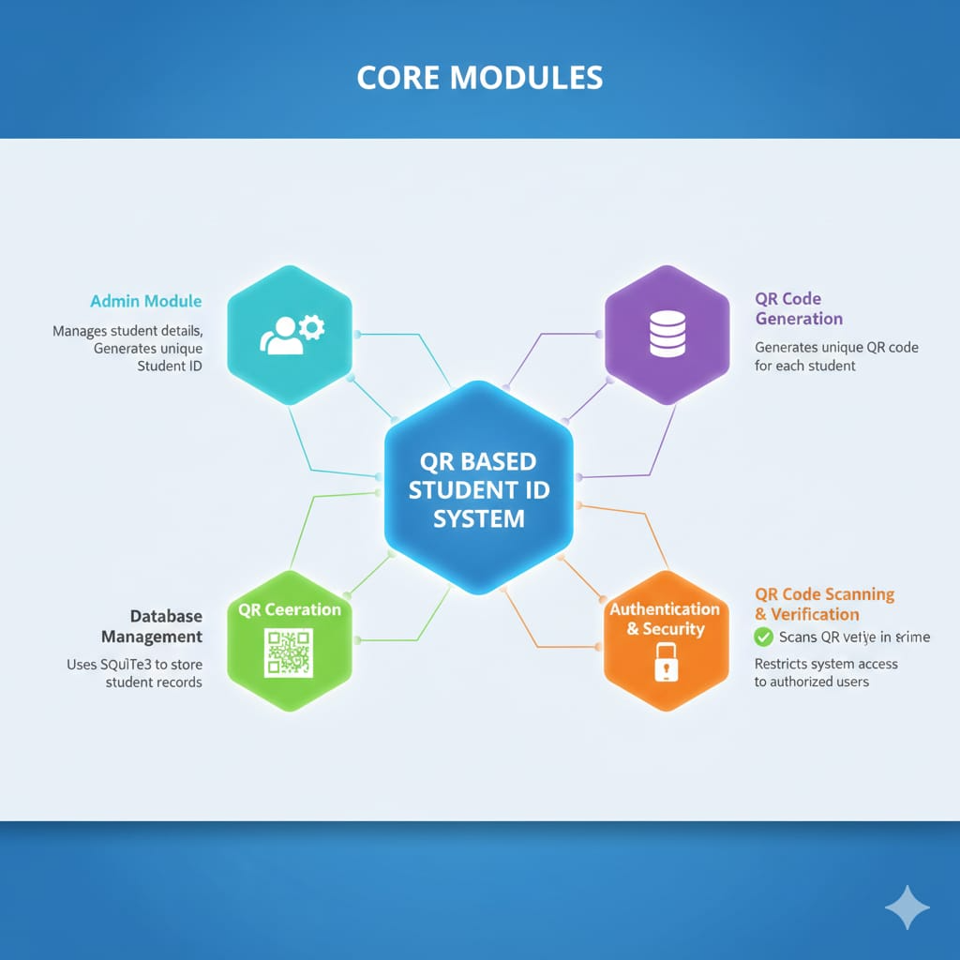
CORE MODULES:
Admin Module: Manages manufacturers and assigns unique government codes
Manufacturer Login: Secure login with one-time medicine registration
Medicine Registration: Registers medicine details on blockchain network
QR Code Generation: Generates unique QR code for each medicine
QR Code Scanning: Scans medicine QR code using camera
Verification Module: Fetches and verifies medicine details instantly
Authentication & Security: Restricts access to authorized users only
Database Management: Stores medicine and manufacturer records securely

Slide 13
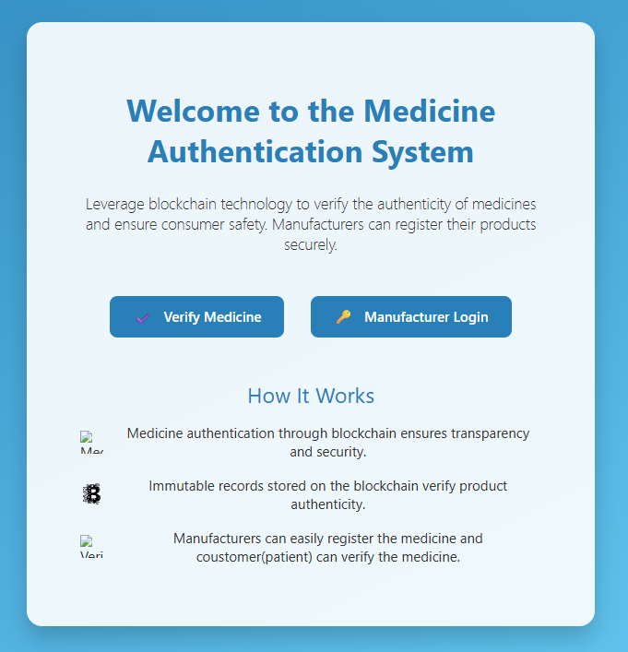
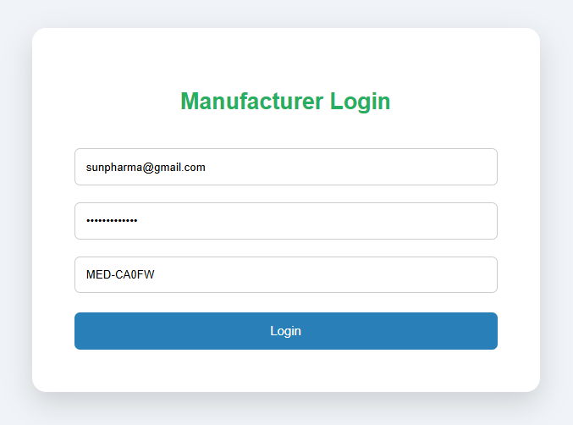

Slide 14
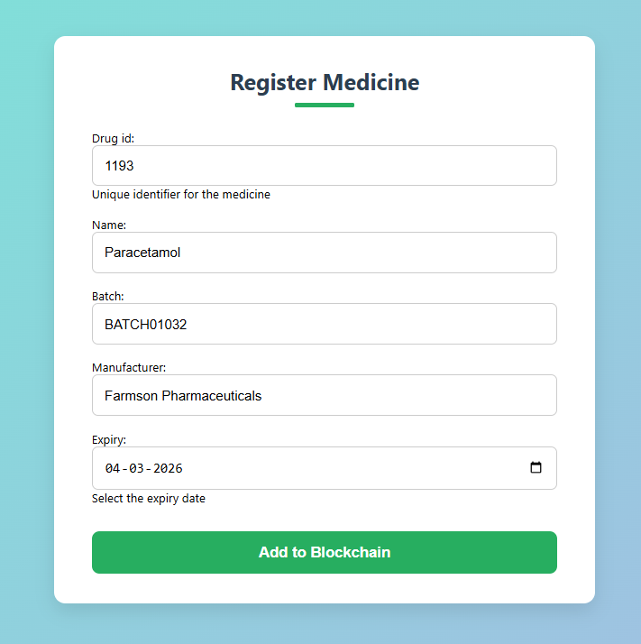
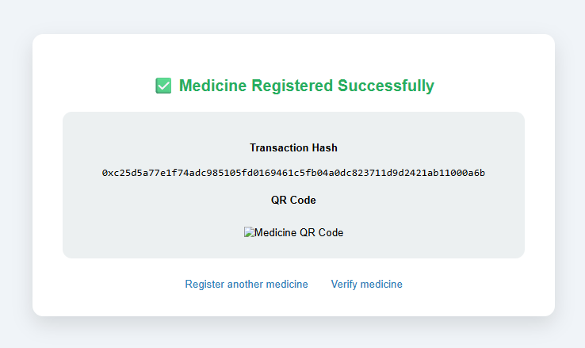

Slide 15
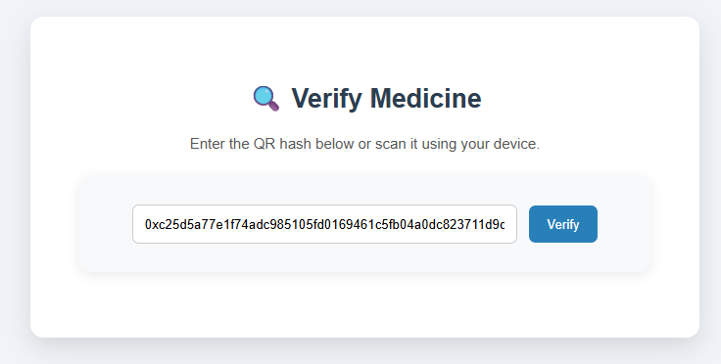
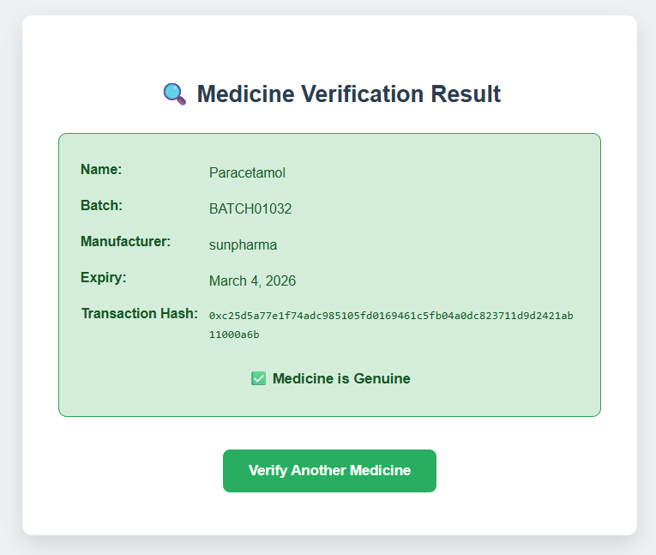

Slide 16
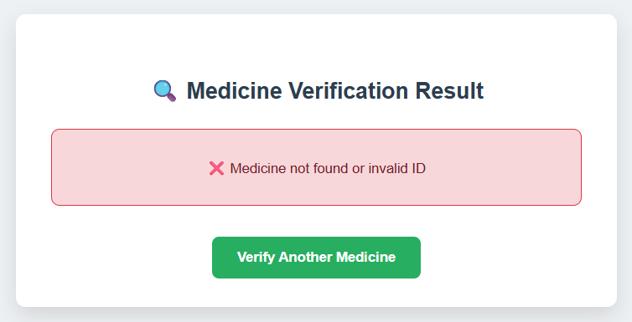

Slide 17
CONCLUSION AND FUTUREWORK:
Fast, secure, and reliable medicine verification system.
Eliminates manual verification and reduces counterfeit medicines.
Real-time tracking of medicines across the supply chain.
Improves transparency and builds trust between manufacturers and consumers
Suitable for pharmacies, hospitals, and healthcare organizations.
Supports government regulations and compliance in the pharmaceutical sector
Integrate biometric authentication for manufacturers to enhance security.
Develop a mobile application for real-time consumer verification.
Expand to multi-country or global blockchain networks for international medicine verification.

Slide 18
References:
ChatGPT – https://chat.openai.com
Notes:
This slide, The speaker will talk about the content that we will be covering in this session as follows:
Introduction
Importance of UI/UX in industry
History and Definitions of UI and UX
Key Differences between UI/UX
Use Cases
Significance in Web Development
Use Cases
Visual Design Principles
Design process
Color theory and psychology
Typography and readability
Layout and Spacing
Responsive design basics
Usability and Accessibility
Usability Aspects
Web Content Accessibility Guidelines (WCAG)
Inclusive design practices
Consistency
User Experience
User-Centered Design
User research methods
Interactive Elements and Feedback
Mini Case Study
Discussing a popular UI/UX design
Hands-On
Introduction to Figma for UI/UX design

